Slide 1


How Angular 2 components communicate
Alain Chautard
www.interstate21.com

Slide 2
Angular 2 Component
A component is a reusable piece of HTML (think widget) bundled with its TypeScript controller
Creating a component is like creating your own HTML element
80%+ of the Angular code you’re going to write will be components
An Angular 2 app is a tree of components
Notes:
A component is made of some TypeScript code, a HTML template and possibly some external CSS files for styling purposes.

Slide 3
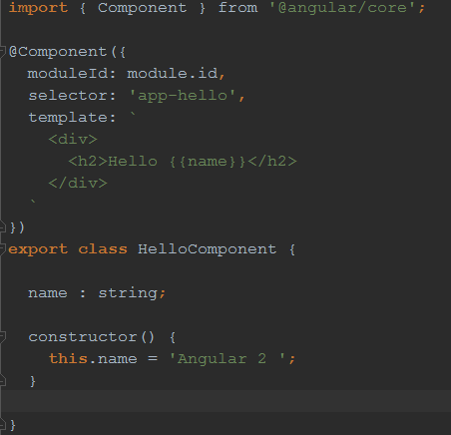
Example of Angular 2 component
A component's application logic—what it does to support the view— is defined inside a class.
The class interacts with the view through an API of properties and methods.
Notes:
In this example, our HelloComponent has a property called name. The constructor function initializes that property to the value “Angular 2”.
Then in our HTML template we have an expression {{name}}, which will substitute {{name}} with “Angular 2” at runtime.
The expression is called “one-way data binding” because if the object data is updated, then the rendered HTML gets updated as well. We don’t have to regsiter any listener or do anything, Angular will do everything for us.

Slide 4
Why would components communicate?
To share some data (username, etc.)
To react to events triggered by other components (when user clicks there, do something somewhere else)
To avoid retrieving the same data from the server over and over again
Notes:
A component is made of some TypeScript code, a HTML template and possibly some external CSS files for styling purposes.

Slide 5
How we did communication in Angular 1
Scope inheritance: Children inherited the scope from their parent controller
$rootScope: A global scope anyone could access
Directives with attributes: Ouch!
Notes:
A component is made of some TypeScript code, a HTML template and possibly some external CSS files for styling purposes.

Slide 6
How to do it with Angular 2: Services
One way to achieve data-sharing between components is to use a service to do that
Services are singletons so these components would access the same data once loaded
Component 1
My Data Service
Component 2
Notes:
A component is made of some TypeScript code, a HTML template and possibly some external CSS files for styling purposes.

Slide 7
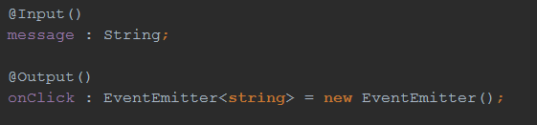
How to do it with Angular 2: Inputs
A new way to achieve communication in Angular 2 is to use @Input and @Output
Input is a way to pass data to a component
Output is a way to emit data from a component
Notes:
A component is made of some TypeScript code, a HTML template and possibly some external CSS files for styling purposes.

Slide 8
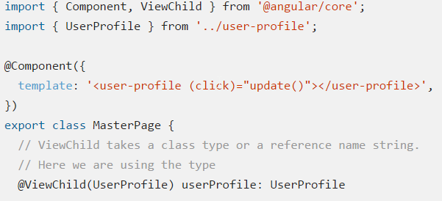
Angular Component Communication
An alternative is to use the @ViewChild decorator to access a child component directly:
Notes:
In that case Angular will inject the first child that matches the selector, which means @ViewChild is not the right option if you need to communicate with several child components from the same type.
Inputs and outputs are the preferred approach as they make the interaction explicit in both the parent and the child component.

Slide 9
The End
Raffle URL:
https://raffle.gdgsacramento.org/
One FREE software license for ANY jetBrains IDE (intelliJ, WebStorm, etc.)
Several O’Reilly books to choose from

